Slide 1
Snapchat, Selfies, and Salvation
Dee Casper, UnScene Media Group

Slide 2
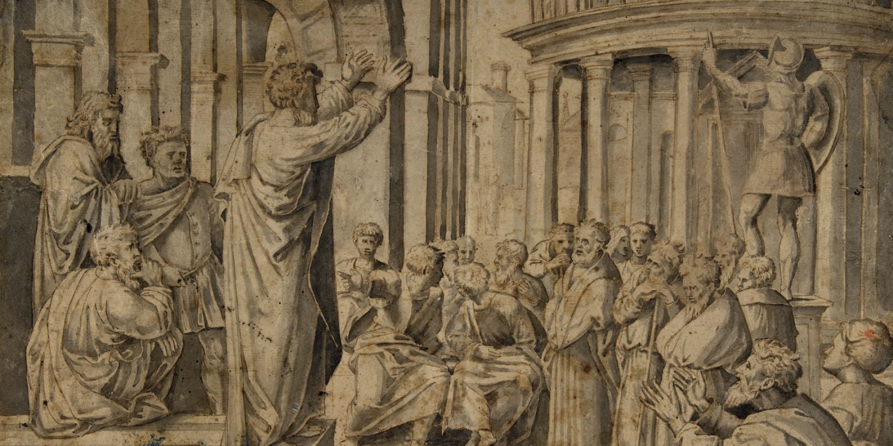
Paul Getting the Gospel to Go Viral
Acts 19

Slide 3
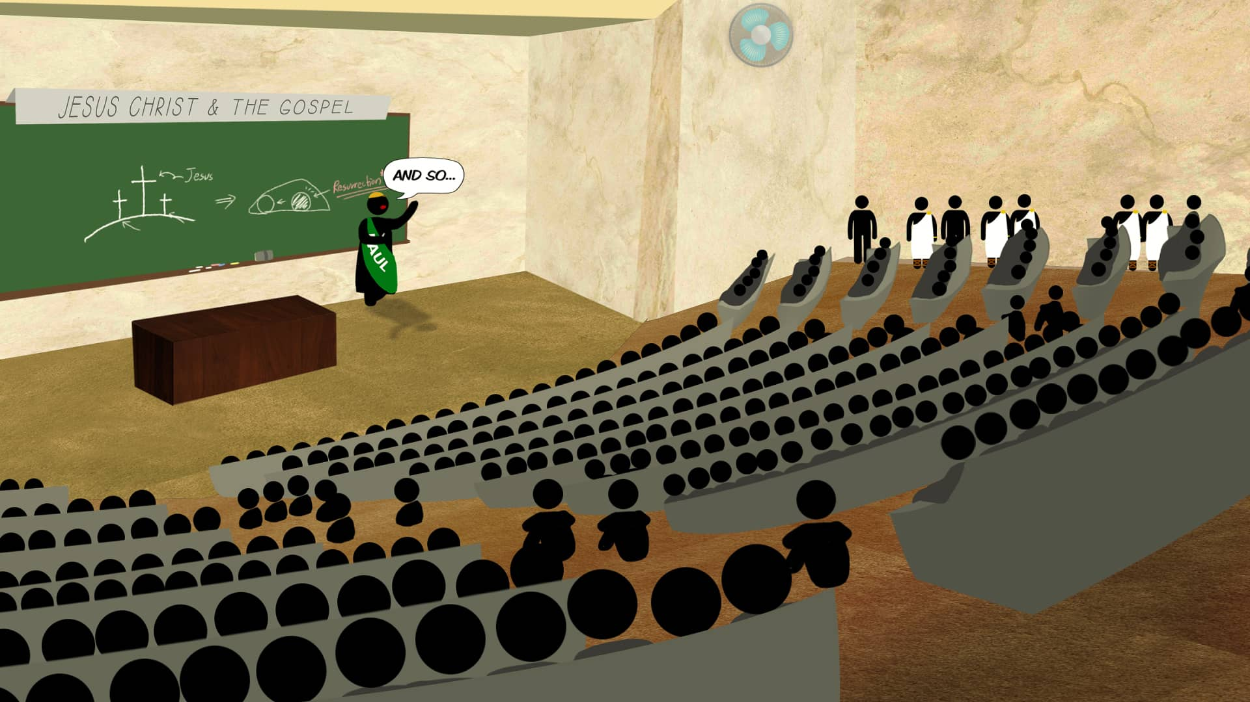
“And this continued for two years, so that all who dwelt in Asia heard the word of the Lord Jesus, both Jews and Greeks.”
Acts 19:10

Slide 4
The School of Tyrannus
A facility in Ephesus that was used in the heat of the day as a place for people to talk about new ideas and teachings after work or school. A place to see and hear new things when they had nothing else to do

Slide 5
Social Media is the New School of Tyrannus
People are hanging out here to see and hear new things to kill time after work and school.
Let’s be honest, they are they’re doing it at work and school too

Slide 6
-World population 7.6 Billion
-3.8 Billion are on the internet
-2.8 billion are active on social media
-One billion people are active on Facebook
-One hundred million people use instagram every month
-91% of retail brands use 2 or more social media accounts
Some Staggering Statistics

Slide 7
-Internet users have an average of 5.54 social media channels
-75% of Facebook users and 50% of Instagram users visit sites daily
-Social meda use increased by 482 Million since Jan 2016
-1 million new active mobile social users are added every day. That’s 12 each second
-Facebook messenger and WhatsApp handle 60 billion messages a day
Some Staggering Statistics

Slide 8
-On any given day Snapchat reaches 41% of 18-34 year olds in the US
-50% of 18-24 year olds go on Facebook when they wake up
-Average daily time used on social media in 2016 is 118 minutes
Some Staggering Statistics

Slide 9
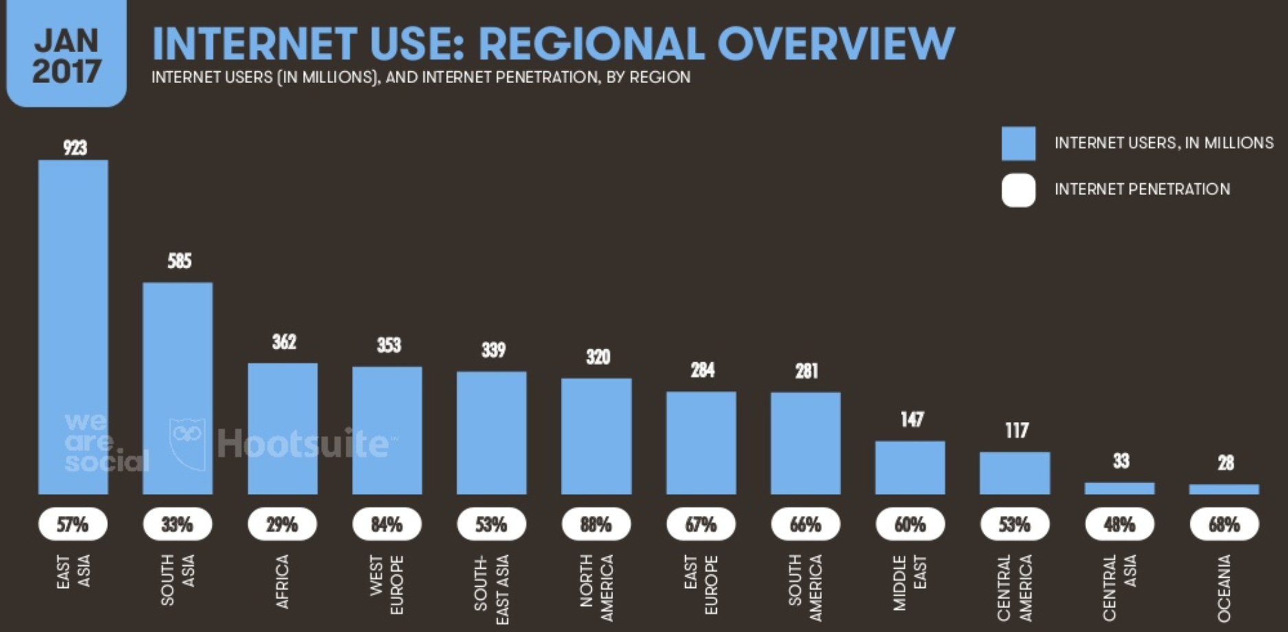

Slide 10
Facebook 1.9 Billion
YouTube 1 Billion
Instagram 600 Million
Twitter 317 Million
Snapchat 300 Million
Profiles for Major Social Networks

Slide 11
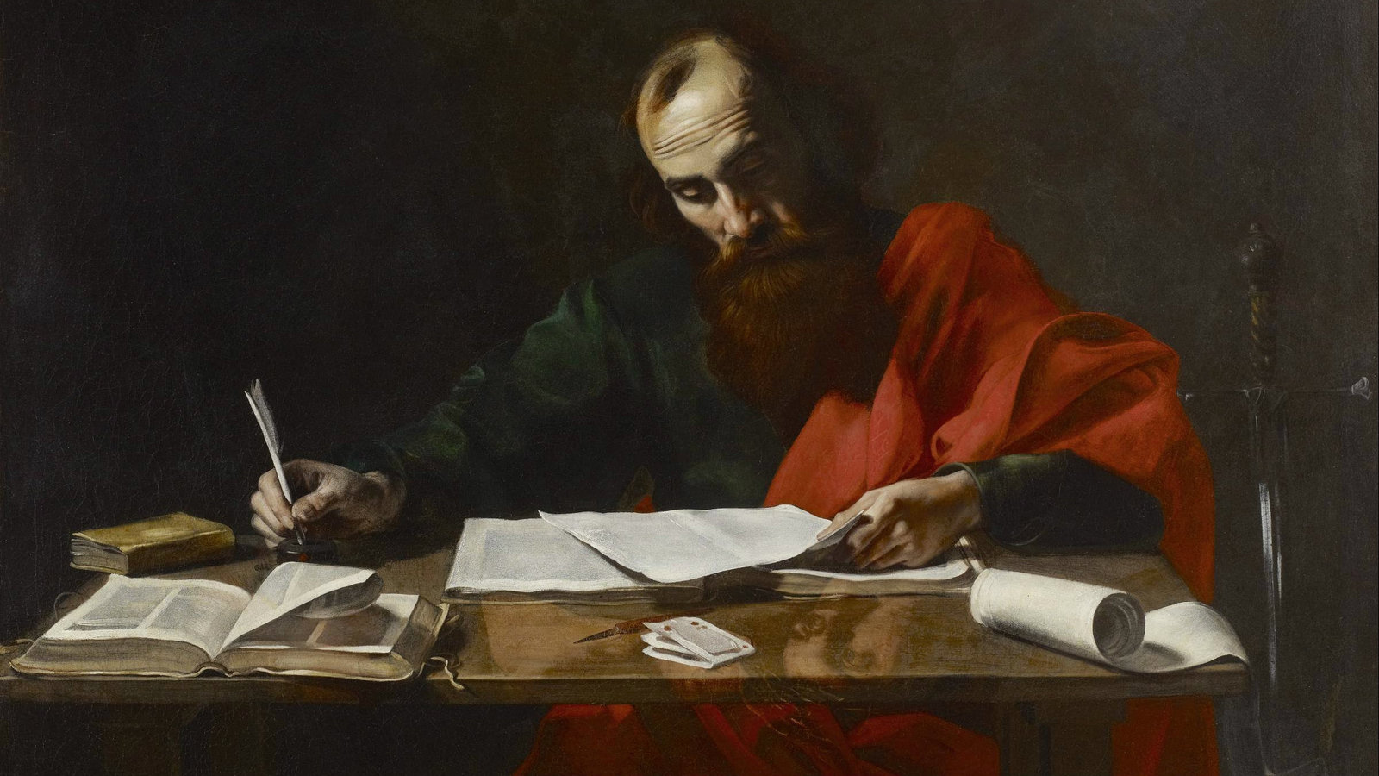
The Apostle Paul’s mouth would be watering if he could access this many people this easily

Slide 12
Yeah, but isn’t there a lot of bad stuff on social media?

Slide 13
Terrorist Propaganda

Slide 14
Violence

Slide 15
Cyber Bullying

Slide 16
Pornography

Slide 17
Facebook Live

Slide 18
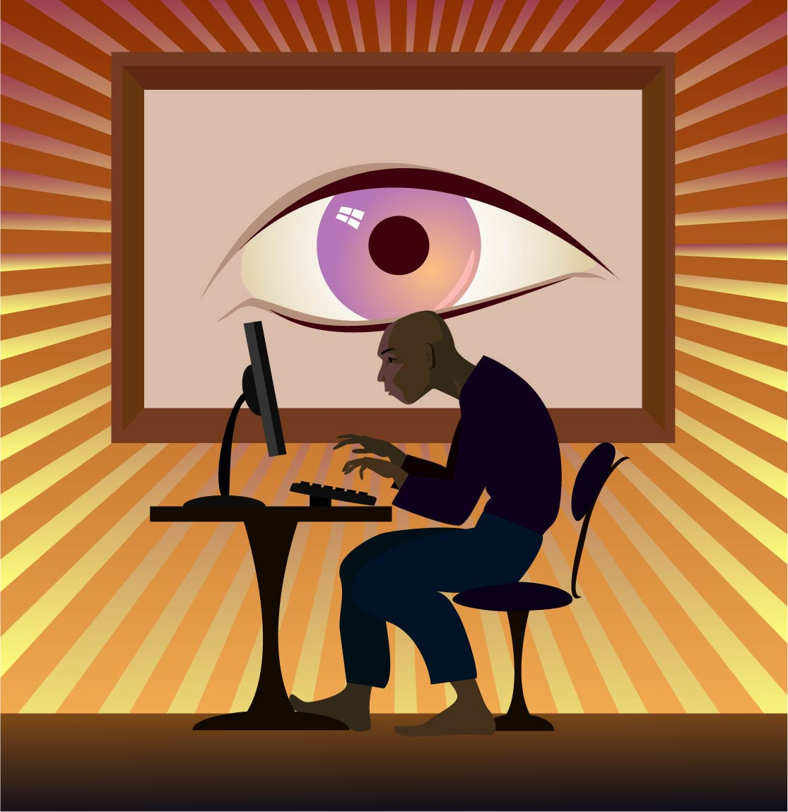
Spiritualism

Slide 19
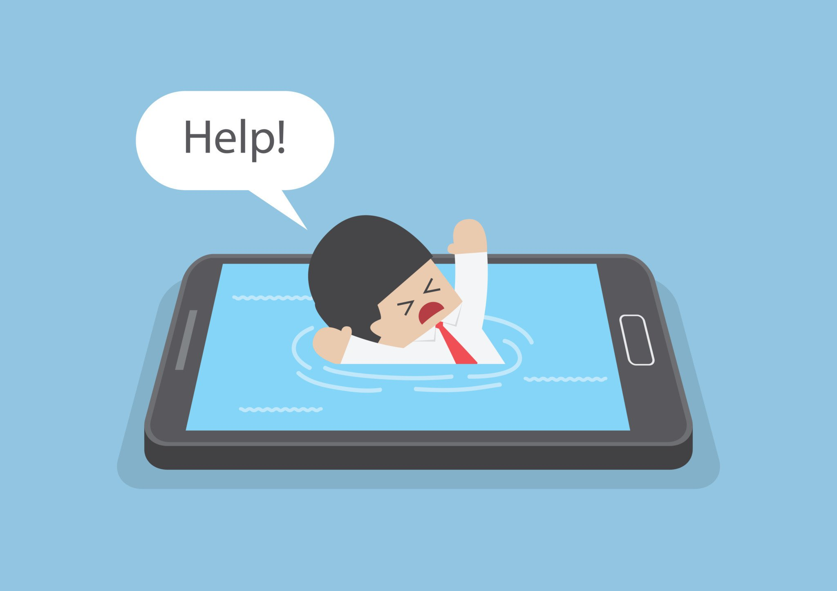
Addiction and How Social Media Shapes the Brain

Slide 22
“Our bodies are physiologically rewarding ourselves for talking about ourselves online”

Slide 23
The very areas of our brain that have to do with intimacy in relationships are activated when we get notifications online. That’s one of the reasons that depression and loneliness is commonly experience alongside heavy usage. It doesn’t deliver like real relationships do

Slide 25
There’s a reason you get notifications about what other people are doing, not related to your posts. They are trying to pull you back in
You don’t have to chase notifications

Slide 26
Some Important Thoughts:
1) All addictive behavior is an attempt to numb pain
2) What thoughts am I trying to avoid?
3) Have I brought my brokenness to Jesus, or am I looking to the attention of others to fill that void?

Slide 27
Some Important Thoughts:
4) Is the cause I’m posting about my way of escaping my real brokenness?
5) Does running “so and so” down numb the pain and the insecurity I feel?

Slide 28
“Only he who has no power needs to control” Horst Muller

Slide 29
Some Helpful Steps:
You choose when you reply and look
Why am I on here?
Treat it like the post office
“Don’t shop when you’re hungry”

Slide 30
Some Helpful Steps:
Am I looking for affirmation and attention?
Down time when you wake up and go to bed
Be honest with yourself, if you need to take time away, do it
But deal with the real root issues, otherwise you’ll just jump back in

Slide 31
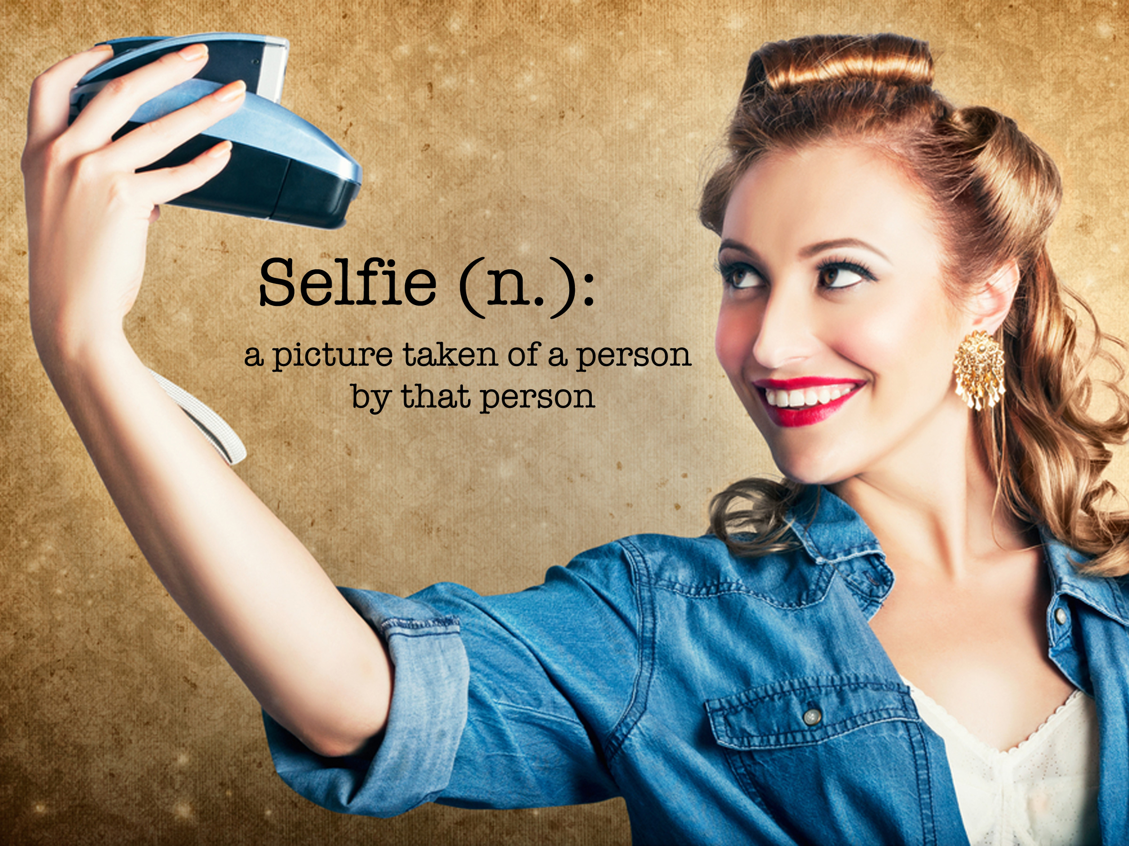
Self(ie)-ishness

Slide 32
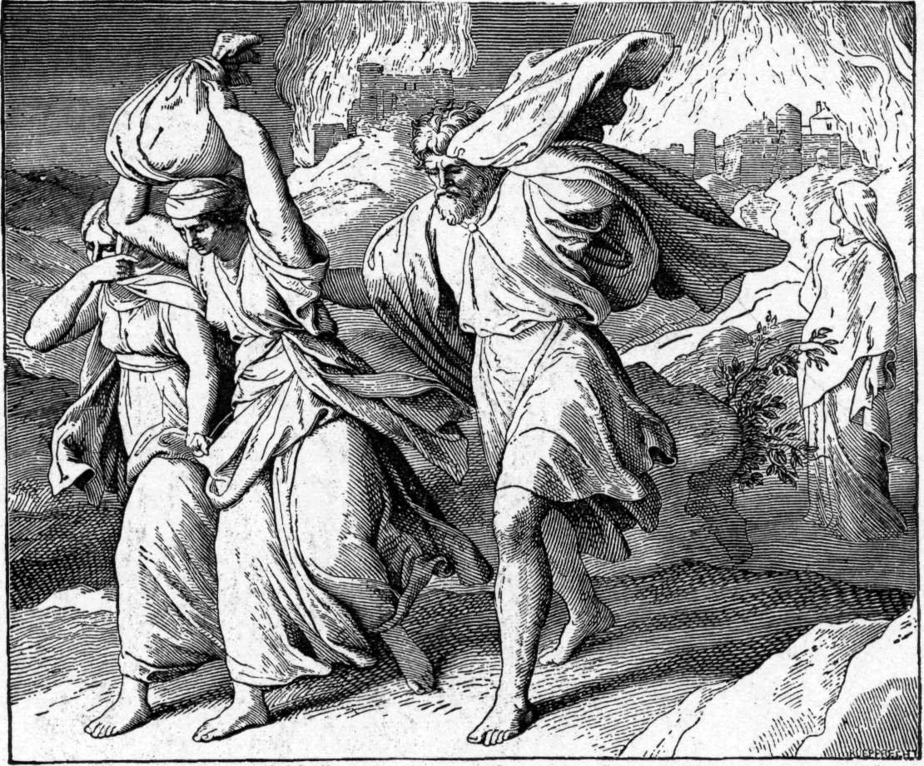
A lesson from the life of Lot

Slide 33
“But the men of Sodom were exceedingly wicked and sinful against the LORD.”
-Genesis 13:13

Slide 34
“So Lot went out and spoke to his sons-in-law, who had married his daughters, and said, ‘Get up, get out of this place; for the LORD will destroy this city!’”
-Genesis 19:14

Slide 35
“But to his sons-in-law he seemed to be joking.”
-Genesis 19:14

Slide 36
Why do you think they responded to his urgent warning this way?

Slide 37
Lot’s concession and comfort killed his witnessing potential. And when the day of judgment came, his ability to save people and pull them out of that environment was severely hampered.

Slide 38
Lot is referred to as a righteous man, but his righteousness didn’t save his family once he presumptuously moved his whole life into Sodom

Slide 39
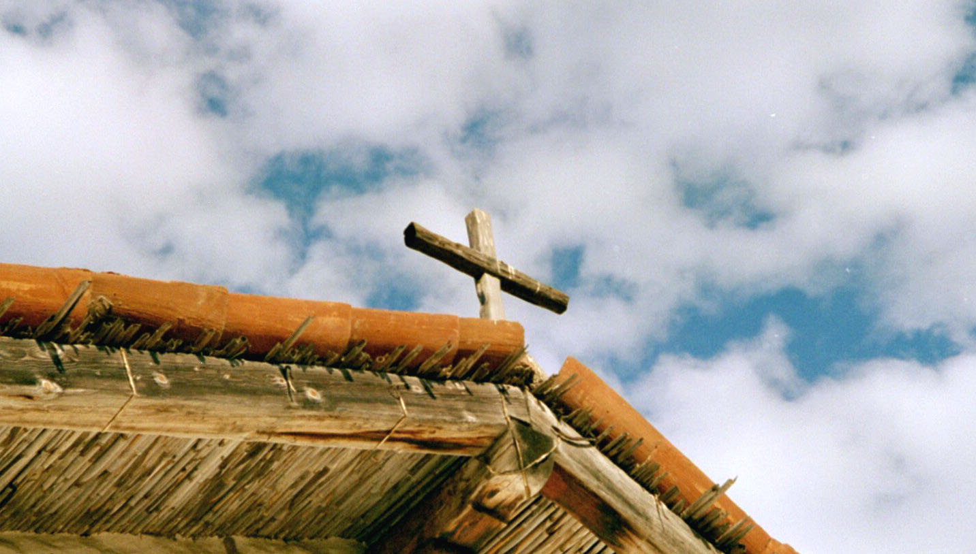
The new outpost center

Slide 40
Outpost Center
A missionary community outside of a city that provides education, restoration, and preparation for work that is to be done in the city

Slide 41
Outpost Center
They establish a center of influence inside of the city to win their trust and friendship, all with the goal of making intentional efforts to win their souls

Slide 42
God has not called us to live “in” social media. But He has called us to influence people in/with social media

Slide 43
“We should choose the society most favorable to our spiritual advancement, and avail ourselves of every help within our reach; for Satan will oppose many hinderances to make our progress toward heaven as difficult as possible.”

Slide 44
“We may be placed in trying positions, for many cannot have their surroundings what they would; but we should not voluntarily expose ourselves to influences that are unfavorable to the formation of Christian character.”
-Messages to Young People 419.1

Slide 45
“When duty calls us to this, we should be doubly watchful and prayerful, that, through the grace of Christ we may stand uncorrupted.”
-Messages to Young People 419.1

Slide 46
Some counsel on things to avoid

Slide 48
Nothing frightens me more than to see the spirit of variance manifested by our brethren. We are on dangerous ground when we cannot meet together like Christians, and courteously examine controverted points.
1888 534.3

Slide 49
I feel like fleeing from the place lest I receive the mold of those who cannot candidly investigate the doctrines of the Bible. Those who cannot impartially examine the evidences of a position that differs from theirs, are not fit to teach in any department of God’s cause. 1888 534.3

Slide 50
"As I became able to join in play with my young friends, I was forced to learn the bitter lesson that our personal appearance often makes a difference in the treatment we receive from our companions… – {LS 18.4}

Slide 51
"...It was the hardest struggle of my young life to yield to my feebleness, and decide that I must leave my studies, and give up the hope of gaining an education. – {LS 19.2}"

Slide 52
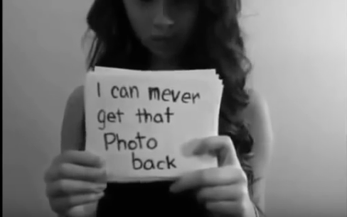
Amanda Todd

Slide 53
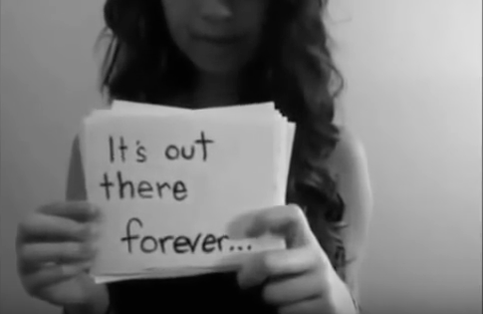
Amanda Todd

Slide 54
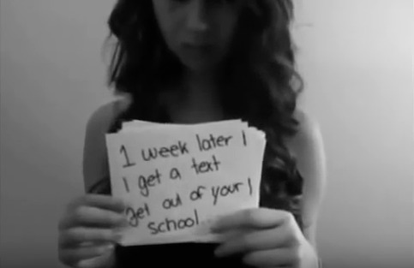
Amanda Todd

Slide 55
Amanda Todd

Slide 56
Amanda Todd

Slide 57
You’re not alone, you DO have Someone

Slide 58
Jesus’ Experience
Viewed as unattractive-Is 53:2
Rejected-Is 53:3
Alone in His grief-Is:52:3
Physically wounded-Is 53:5
Was quiet about abuse-Is 53:7

Slide 59
Jesus’ Experience
Ridiculed and mocked-Ps 22:6-8
Stripped and cried to God for help
Ps 22:18-21
Tempted to harm Himself-Mt 4:5-6

Slide 60
Jesus’ Experience
Betrayed by someone He trusted
Mt 26:48-49
Tempted to numb pain by drinking wine
Mt 27:34
Publicly exposed and shamed-Mt 37:35

Slide 61
If you have been bullied and abused, know that Christ went through this to be able to comfort you in ways that no-one else can
Hebrews 2:17-18
Hebrews 4:14-16

Slide 62
If you have seen people bullied, do something about it
We’re more than willing to share our disgust over political and religious things. But we watch things like this happen and say nothing

Slide 63
So Is Social Media A Sin?
It depends

Slide 64
Questions?

Slide 65
@deecasper24
@unsceneme
@unscenemediagroup
@dcasper24
@unsceneme
@deecasper24
/c/deecasper
/unscenemedia
Dee Casper

