Slide 1
Why God Won’t Leave
Dee Casper
www.ARtvNow.com

Slide 2
The Old Testament God

Slide 3
Ezekiel 18:23; 33:11

Slide 4
2 Peter 3:9

Slide 5
God does not rejoice over the death of anyone
No one creates something out of love, and then takes enjoyment in destroying it

Slide 6
What more could I do?
Isaiah 5:1-7

Slide 7
Some would say that God should stop it from happening
Let’s read Genesis 2

Slide 8
A warning in love
Genesis 2:15-17

Slide 9
You can imagine God saying the same thing as Isaiah 5. What more could I have done?

Slide 10
Hostage negotiation
Genesis 4:1-8

Slide 11
You’ve heard it said, “I’m not going down without a fight.”
I would phrase it this way
“God is not letting you go down without a fight”

Slide 12
A voice of reason throughout salvation history
Genesis 2 & 4
Moses & the patriarchs
Prophets
400 year cessation
John the baptist
Jesus Himself
Holy Spirit
Rev 14 & 18

Slide 13
Who says God has to go through all of this effort?
This shows us how much He wants us to be saved

Slide 14
Not only does He give us a voice of reason,
He also gives us power to life a holy life
Ezekiel 36:22-32

Slide 15
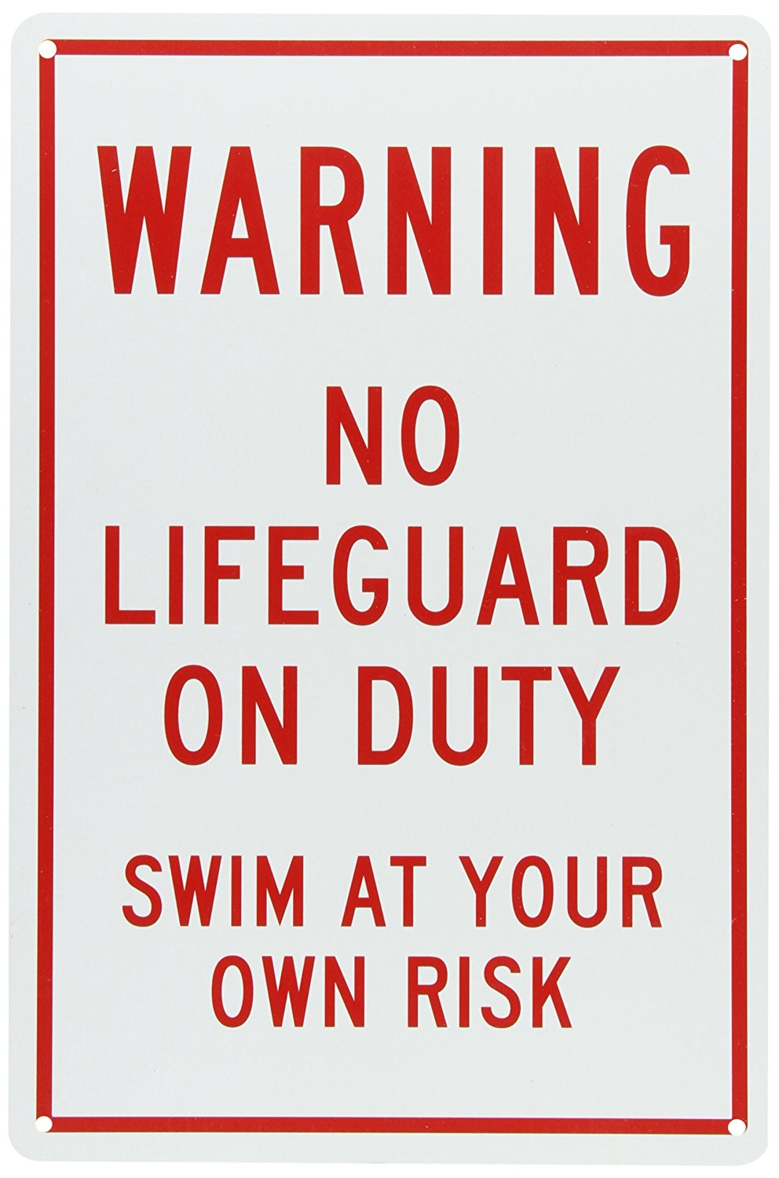
Again, who says God has to do this for us?

Slide 16
Ezekiel 36=God’s Extravagant Provision
And His amazing desire to see you saved
You’re dirty? —> I’ll cleanse you
Got idols? —> I can get rid of them
Have a stony heart? —> I’ll give you a new one
Cold & indifferent? —> I’ll help you feel again
Can’t obey? —> I’ll empower you to obey
Any more objections?

Slide 17
The people who are lost at the end of time are not lost because God did not make ample provision

Slide 18
They are lost because they had no desire to take God up on His amazing offer.
Many of us are shaming ourselves out of heaven.
Or we are allowing the devil himself, and the people around us to do it

Slide 19
Many will be lost by not taking hold of God’s belief in them
“they did not receive the love of the truth, that they might be saved.” 2 Thess 2:10

Slide 20
Nature V Man
Jeremiah 5:20-25

Slide 21
“We spurn our Creator’s authority over us. God beckon storm clouds, and they come. He tells the wind to blow and the rain to fall, and they obey immediately. He speaks to the mountains, “You go there,” and he says to the seas, “You stop here,” and they do it. Everything in all creation responds in obedience to the Creator…until we get to you and me. We have the audacity to look God in the face and say, “No.”
-David Platt, Radical: Taking Back Your Faith From the American Dream

Slide 22
Looking for reason
Micah 6:1-4, 8

Slide 23
They have not heeded my voice
Jeremiah 6:16-20

Slide 24
Displacing God
Ezekiel 8:6

Slide 25
Climax of Old Testament God’s pleas for His people
Matthew 23:37

Slide 26
An enduring Fatherly love
Isaiah 65:2

Slide 27
We plead with God, asking why bad things happen
God asks the same question. In a different way
Why would you reject my grace and be turned over to the consequences of sin?

Slide 28
All throughout the Old Testament we have seen God pursuing His people at the expense of His own heart, at the expense of His own embarrassment, trying to win them over. Heartbroken and devastated, He continues nonetheless

Slide 29
Israel’s audacity
Isaiah 49:14-16

Slide 30
Who’s forsaking who?

Slide 31
God is using explicit Calvary language
If anything shows us that God has not forgotten us, it’s Calvary

Slide 32
How could you say something like that about me?
Especially after all I have done to try to bring you back to me
In spite of how you have hurt me

Slide 33
An invitation
Revelation 3:20

Slide 34
Behold, I stand at the door and knock
Continuative in Greek
I have been knocking, I am knocking now, and I will continue to knock

Slide 35
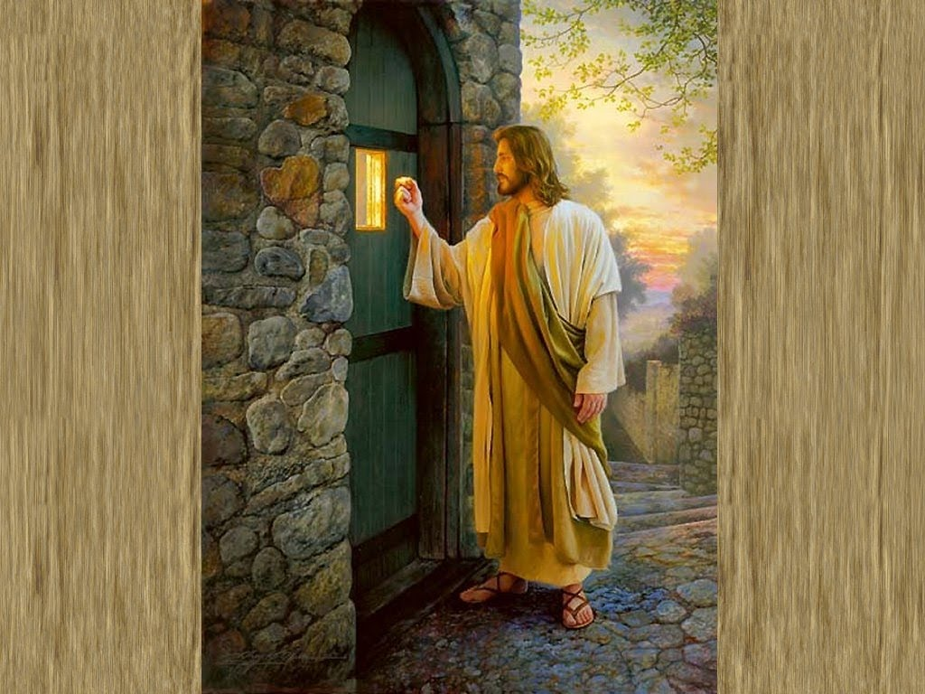

Slide 36
Jesus can reason with us
He can communicate and show us a better way
But the choice remains ours
He only works through love, and love allows for choice

Slide 37
What will you do with the pleading of Jesus?

Slide 38
Scripture is clear
God is not giving up on you
But He will eventually have to yield to you giving up on yourself
This is what breaks His heart and brings Him to tears

Slide 39
The Old and New Testament picture shows the same story:
“…He who has seen me has seen the Father” John 14:9
"Having loved His own who were in the world, He loved them to the end." John 13:1

Slide 40
Does God Care?
More than you’ll ever know

Slide 41
Does God hurt when I hurt?
You better believe it
He hurts when you don’t hurt
He hurts all the time in the great controversy
This is why He won’t leave and keeps pleading with the lost as long as He can

Slide 42
“Those who think of the result of hastening or hindering the gospel think of it in relation to themselves and to the world. Few think of its relation to God. Few give thought to the suffering that sin has caused our Creator…

Slide 43
“All heaven suffered in Christ's agony; but that suffering did not begin or end with His manifestation in humanity…

Slide 44
“The cross is a revelation to our dull senses of the pain that, from its very inception, sin has brought to the heart of God. Every departure from the right, every deed of cruelty, every failure of humanity to reach His ideal, brings grief to Him…

Slide 45
“When there came upon Israel the calamities that were the sure result of separation from God,—subjugation by their enemies, cruelty, and death,—it is said that “His soul was grieved for the misery of Israel.” “In all their affliction He was afflicted: ... and He bare them, and carried them all the days of old.” Judges 10:16; Isaiah 63:9...
-Education 263

Slide 46
This is the response that God has to us saying no
We have to see His side of the story before we say no

Slide 47
If we continue to resist the pursuit and pleading of God, what will happen?
He’ll hurt for eternity

Slide 48
Our experience in being lost and the second death is actually easier than God’s experience
It eventually ends. We eventually cease to exist
God isn’t afforded that option
He has to continue to live with that pain

Slide 49
The appeal for salvation is not just an appeal to put an end to your pain
It’s an appeal to put an end to His
What will your response be?

Slide 50
@deecasper24
@ARtvNow
@dcasper24
@ARtvNow
@deecasper24
@ARtvNow
/c/deecasper
/ARtvNow
Dee Casper

